Slide 1
Scalable Fast Rank-1 Dictionary Learning for fMRI Big Data Analysis
Xiang Li1, Milad Makkie, Binbin Lin, Mojtaba Sedigh Fazli,
Ian Davidson, Jieping Ye, Tianming Liu, Shannon Quinn
At 2016 KDD Conference held at SFO
Team 19
Kanthi KOMAR
Ravi Chandra Kumar Venkatesh

Slide 2

AGENDA
INTRODUCTION
OBJECTIVE
ALGORITHM
ALGORITHM PARALLELIZATION AND DEPLOYMENT ON SPARK
EXPERIMENTAL APPLICATION ON BRAIN fMRI
DEMO
CONCLUSIONS

Slide 3


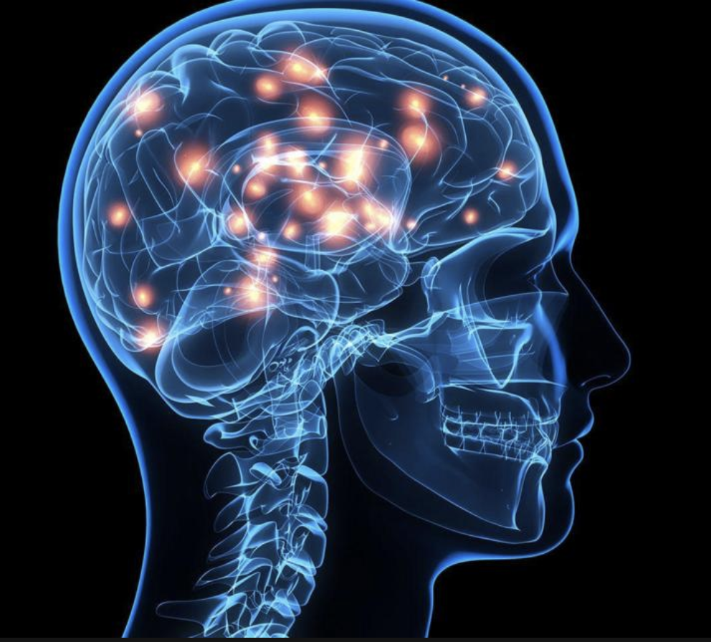
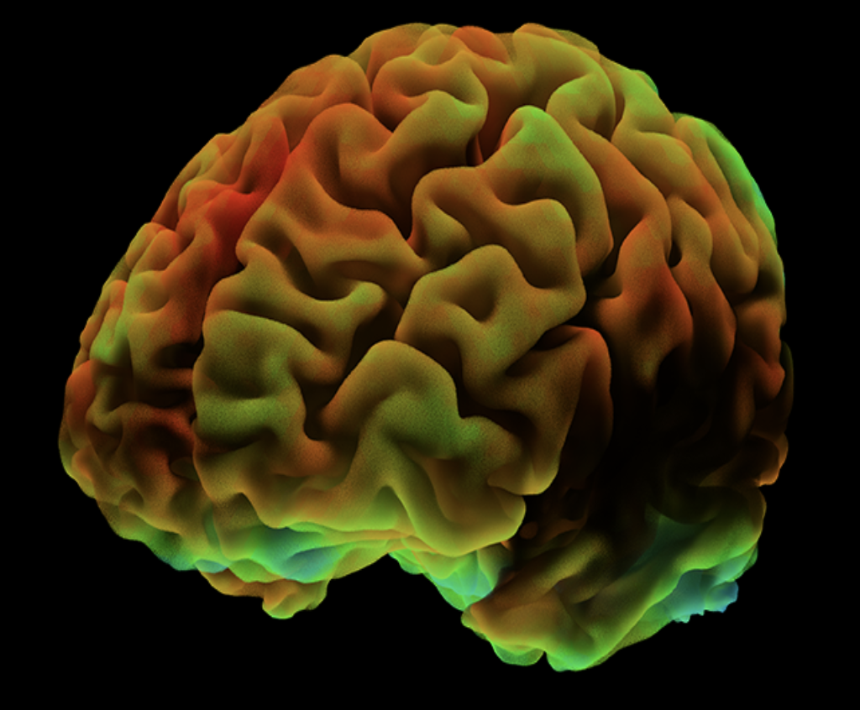
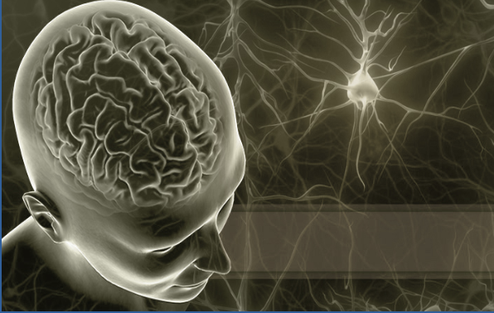
INTRODUCTION
Notes:
The rapidly growing data characterize different aspects of brain cognitive processes as well as various disorders, thus providing a great opportunity for decoding and identification of potential functional biomarkers for brain diseases.
This calls for more efficient and scalable data analytics and knowledge discovery methods, especially for dealing with fMRI big data.

Slide 4
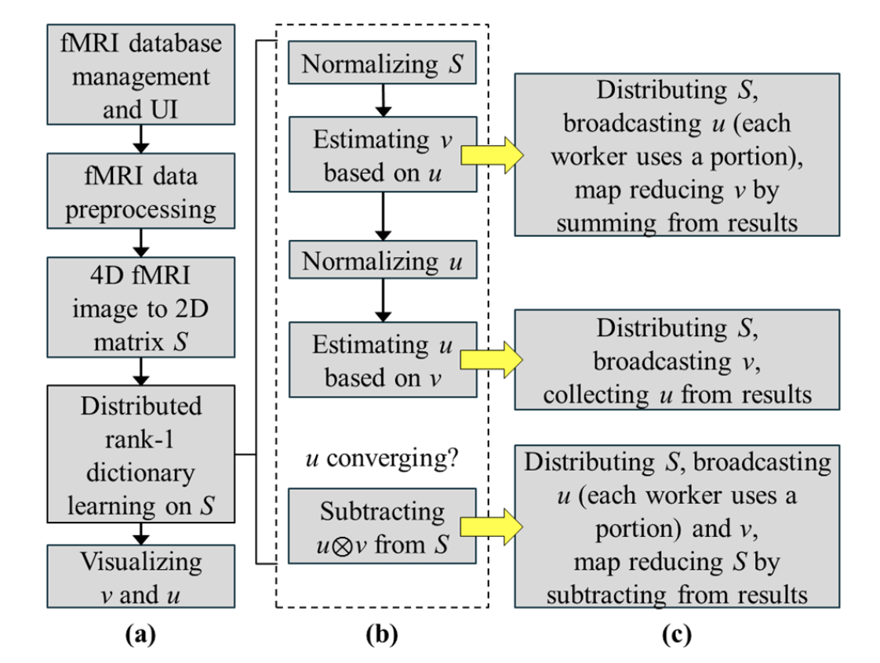
Algorithmic pipeline
Notes:
(a): Operations on the neuro informatics system for preparing the application of D-r1DL and post-analysis.
(b). Algorithm pipeline of the rank-1 dictionary learning
( c ). Parallelization subroutines of the D-r1DL model derived from the corresponding subroutines of the r1DL using Spark. The distribution of input data S is based on RDDs.

Slide 5
OBJECTIVE
a novel distributed rank-1 dictionary learning (D-r1DL) model
leveraging the power of distributed computing for handling largescale fMRI big data.
Compared to the gradient-based dictionary learning algorithms and the K-SVD, the proposed rank-1 dictionary learning algorithm has a few critical advantages
Notes:
to provide an integrated solution for the large-scale fMRI big data analysis

Slide 6
Advantages of the Proposed Algorithm
1) The learning process is a fix-point algorithm by alternating least squares updates
2) The memory cost - very low
very light weighted in terms of the operational complexities:
besides the input data, most of the routines in the algorithm will only take one vector as input and one vector as output.
This feature helps the r1DL algorithm to be easily parallelized to its distributed version.
Notes:
, thus avoiding the tuning of the learning rate/step size while also avoiding the slow convergence near the solution;
Low Memory - because it does not have the needs to maintain the potentially large gradient matrix in the memory. The intermediate results will be discarded after each rank-1 basis is learned and stored, which further reduce the memory cost.

Slide 7
Background
basic Idea: the observed functional signals are the result of the linear combination from the signals of many latent source (i.e. functional networks), plus noises.
The methods then aim to identify the latent source signals as well as the loading matrix
The decomposition results consist of two parts:
1. temporal pattern of the functional networks - regarded as basis activation patterns, and
2. spatial pattern of the functional networks.
Notes:
Functional network analysis based on matrix decomposition methods has the Basic idea
2. the loading matrix characterizing how each source contributes to the formation of each observed signal across voxels/ brain regions (i.e.

Slide 8
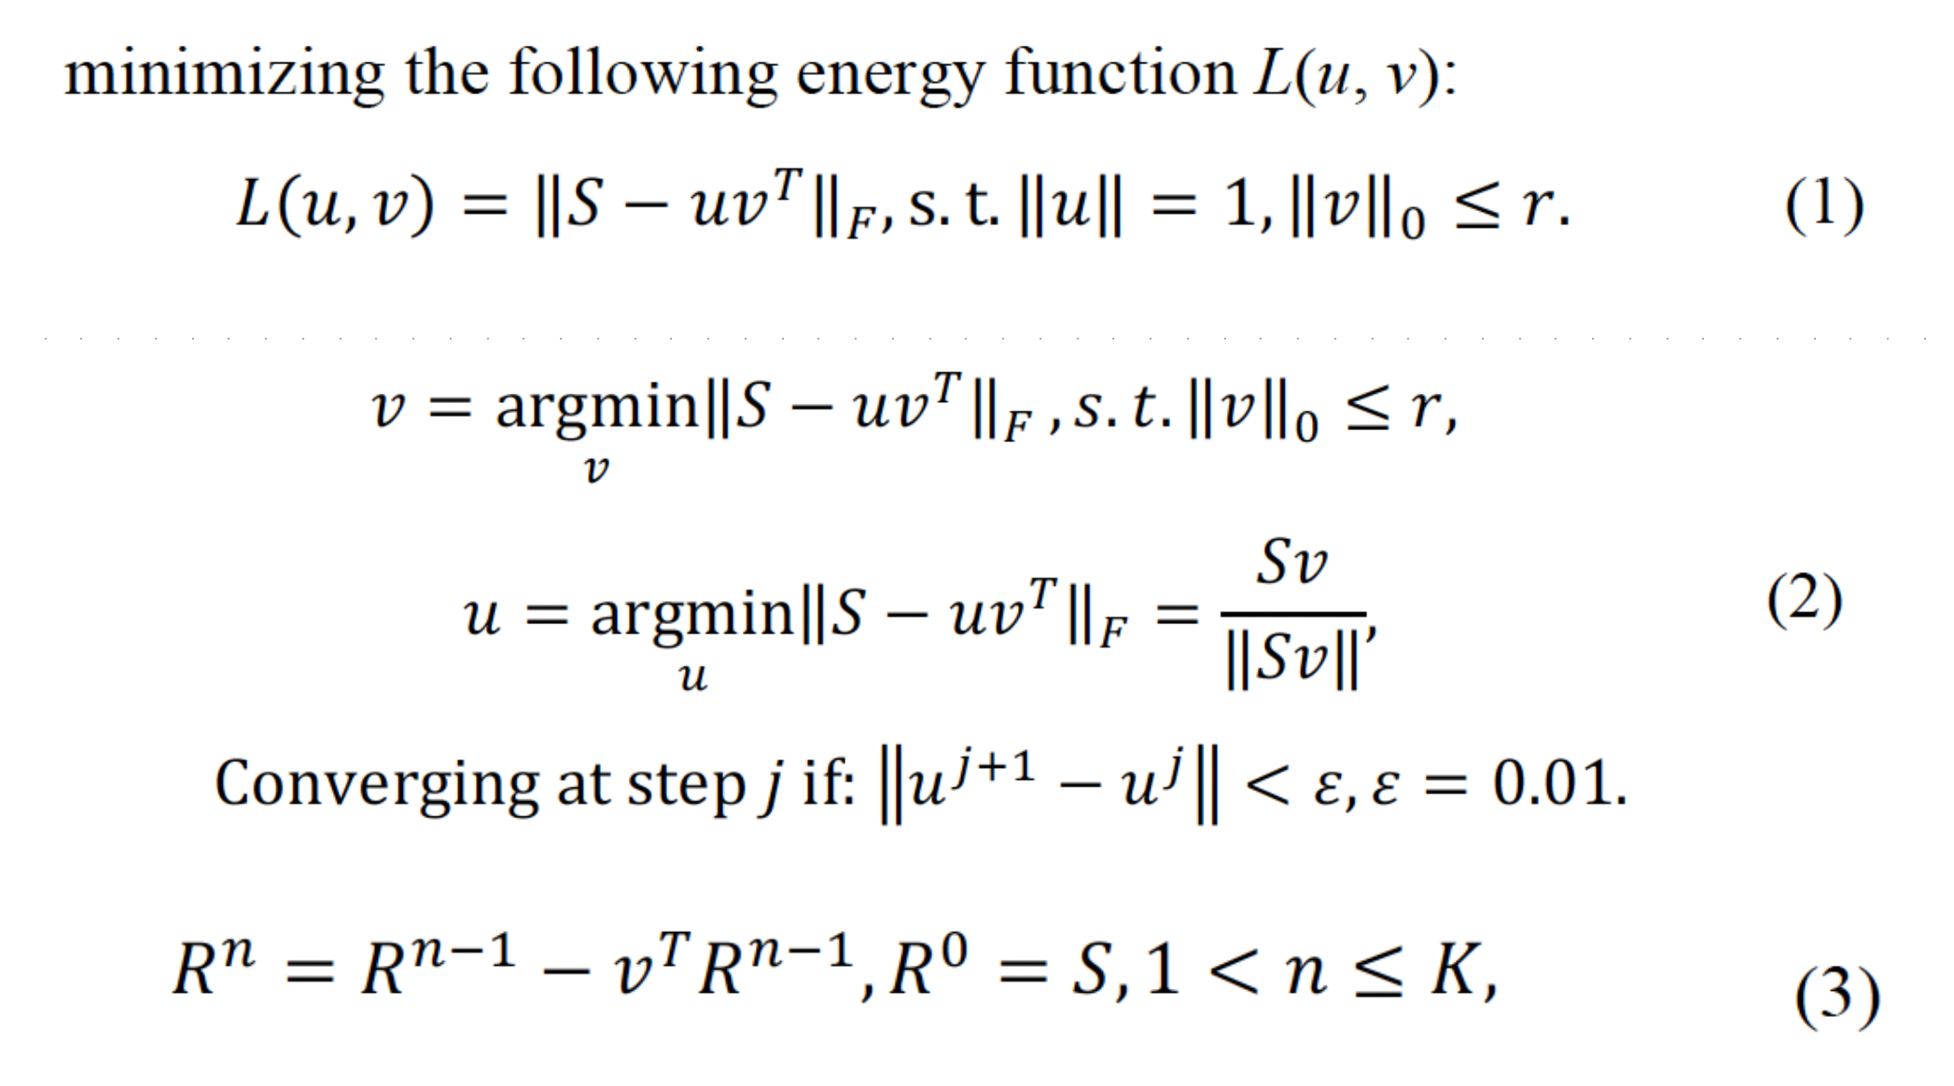
ALGORITHM
Notes:
F => Frobenius norm, also called the Euclidean norm
rank-1 basis vector u (TX1)
its loading coefficient vector v (PX1)
input signal matrix S of dimension TXP,
sparsity-regularization factor – “ r "
It could be seen that the formulation of the proposed rank-1 dictionary learning algorithm is similar to the sparse PCA problem [6]. However, the goal of PCA and sparse PCA is to derive a low-dimensional basis (i.e. learning a smaller set of high representative basis); in contrast, the goal in dictionary learning is to learn an overcomplete dictionary set

Slide 9
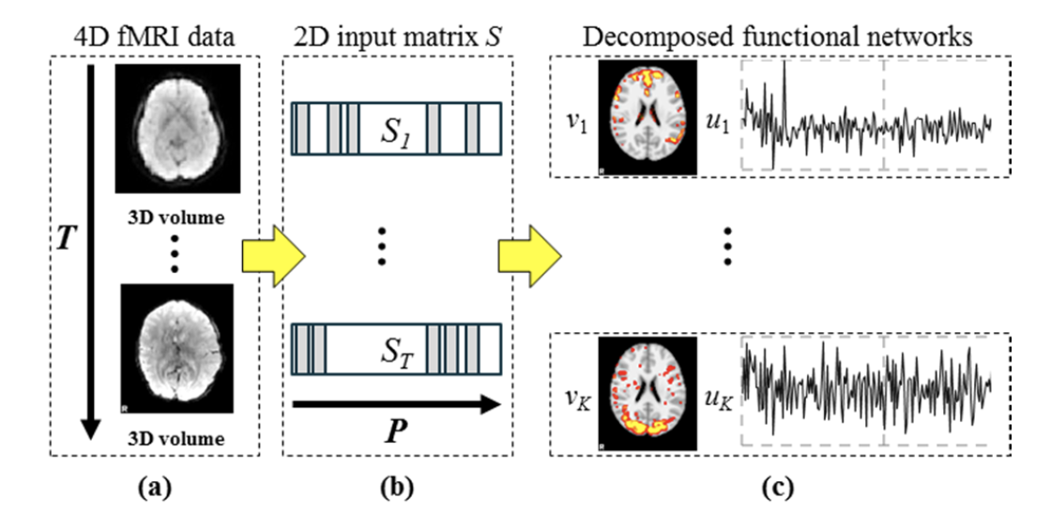
Notes:
K is the total number of expected basis (i.e. dictionary atoms) to be discovered from the input data

Slide 10
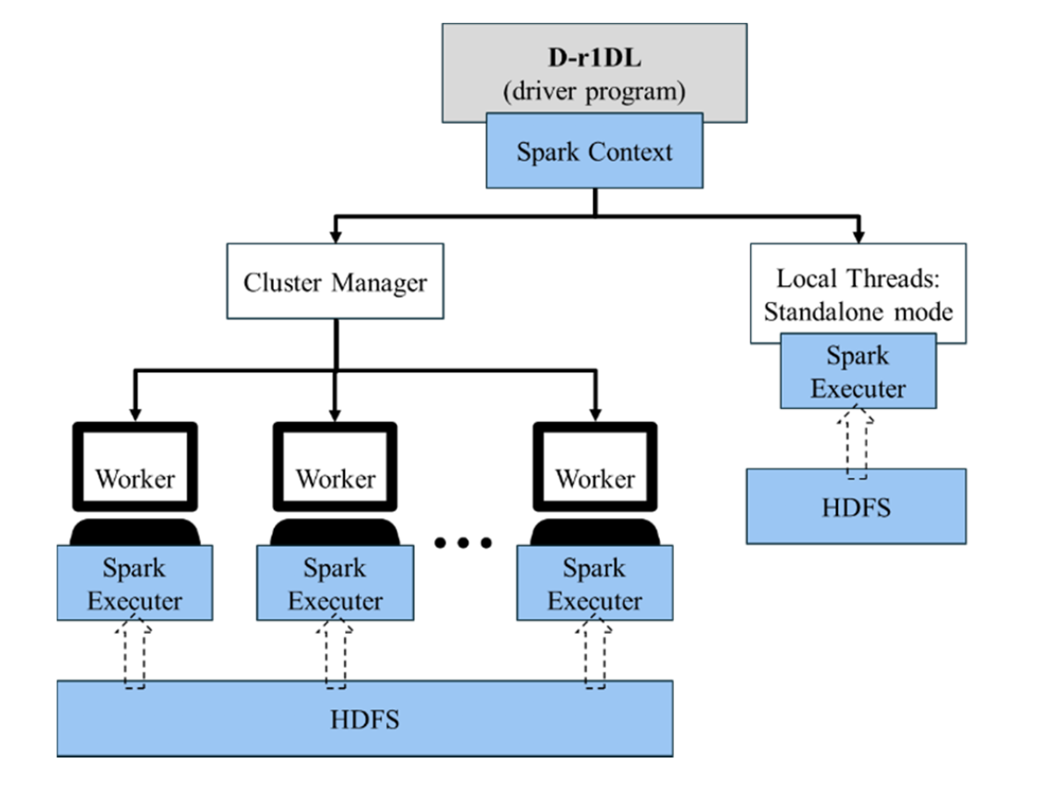
ALGORITHM PARALLLIZATIONAND DEPLOYMENT ON SPARK

Slide 11
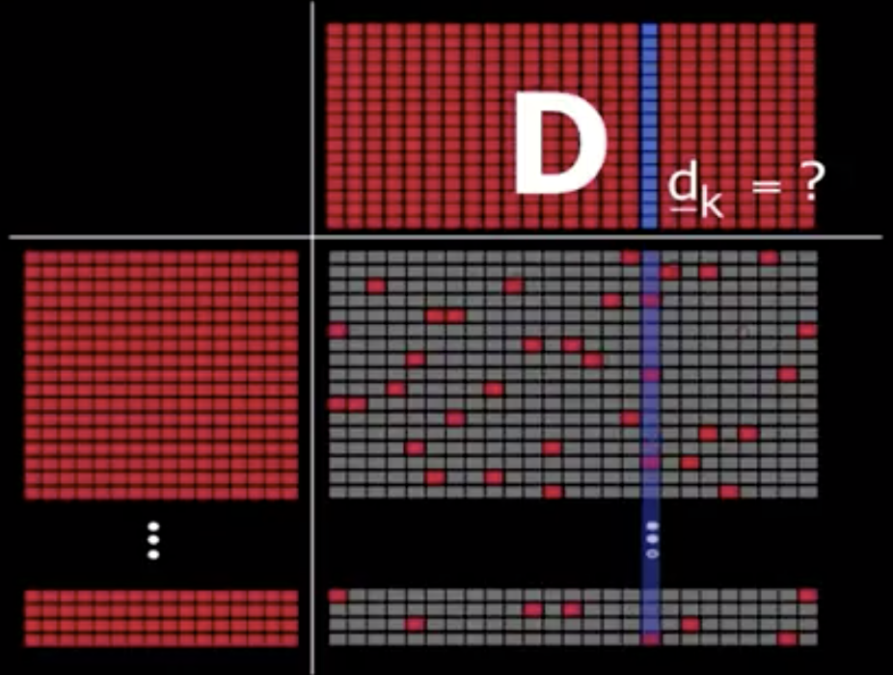
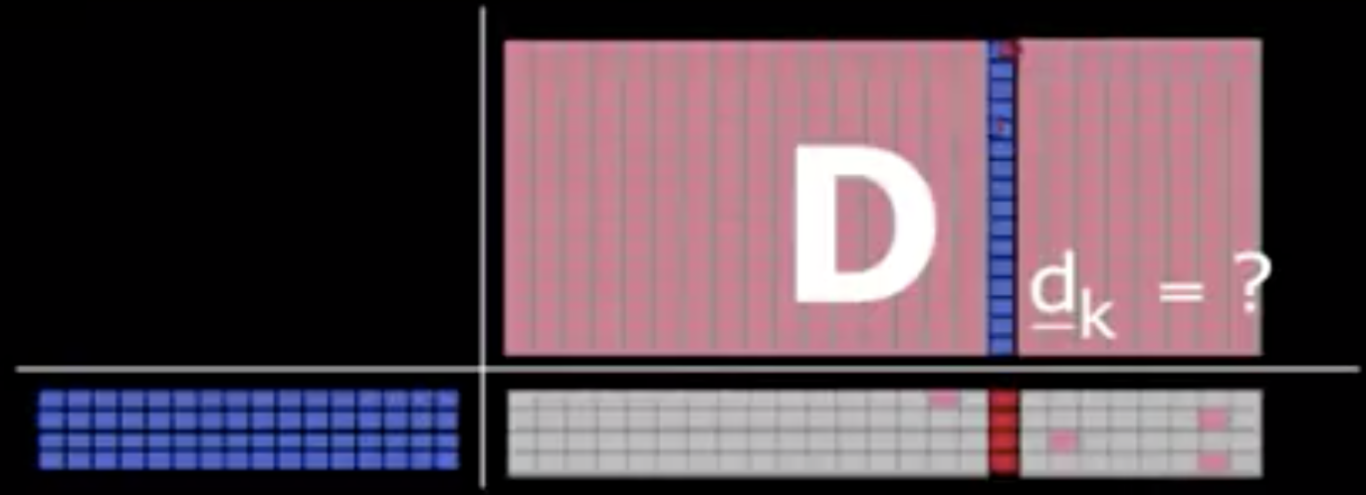
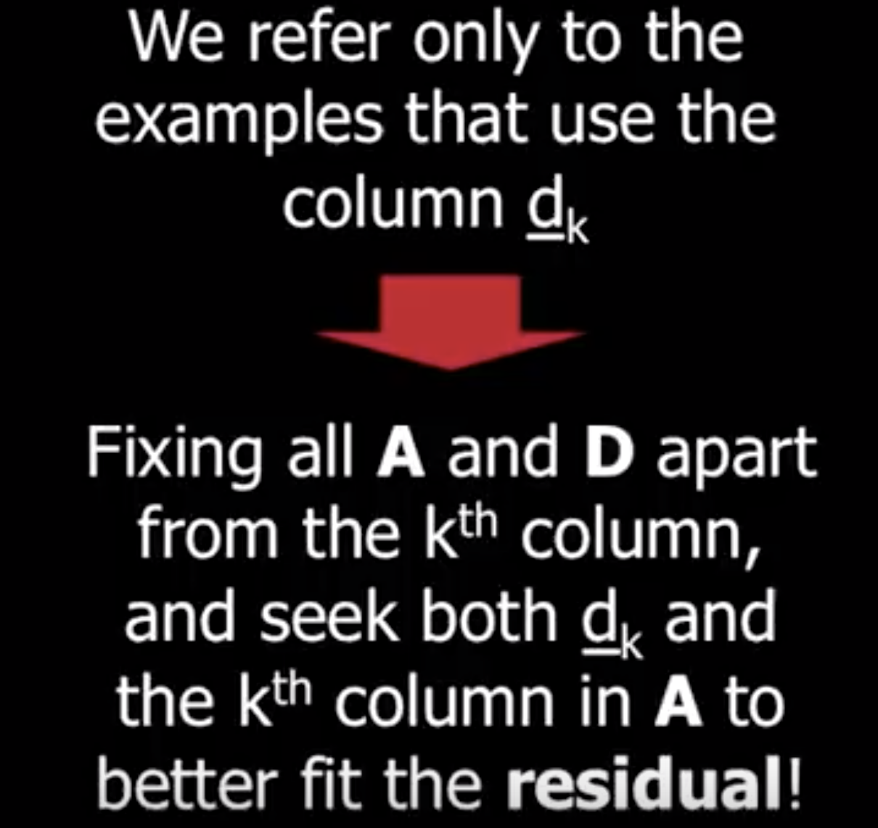
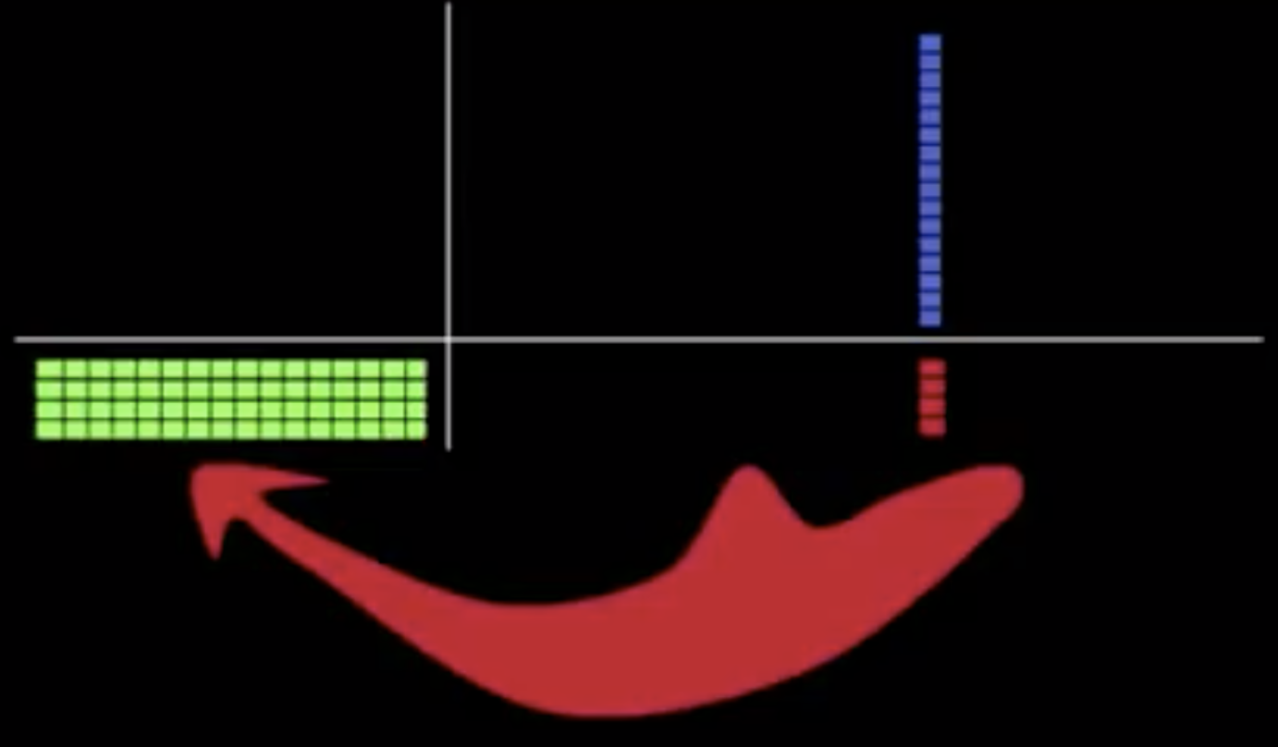




Notes:
S is realized as a RDD (key-value pairs) – each column vector o the original S as one key-value pair => we will in total have P key-value pairs
D = U = Dictionary = each column in the D is an atom (u order T X 1). We have K atoms, and for K > P => overcomplete dictionary
A = V = Co-efficient Matrix = each column vector is v (P X 1)

Slide 12
Distributed rank-1 dictionary learning (D-r1DL) model
the distribution of S to each node as a series of key-value pairs is inherently straight forward: each column in S contains the T number of observations for one specific feature, to the total of P features.
While S was maintained as an RDD, the vectors u and v were broadcast to all nodes.
vector-matrix multiplication:
each node will use its portion of the updated u vector, and then estimate the v vector based on the multiplication of portions of S and u. The resulting v vectors from all the nodes will be then map-reduced by the summation operation.
matrix-vector multiplication:
each node will use all the updated v vector then estimate its corresponding portion of the u vector

Slide 13
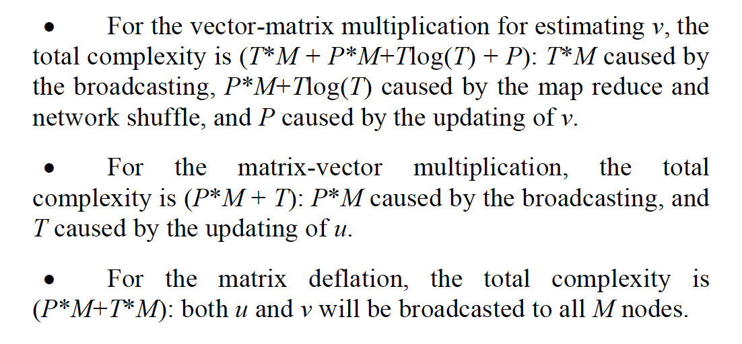

Slide 14
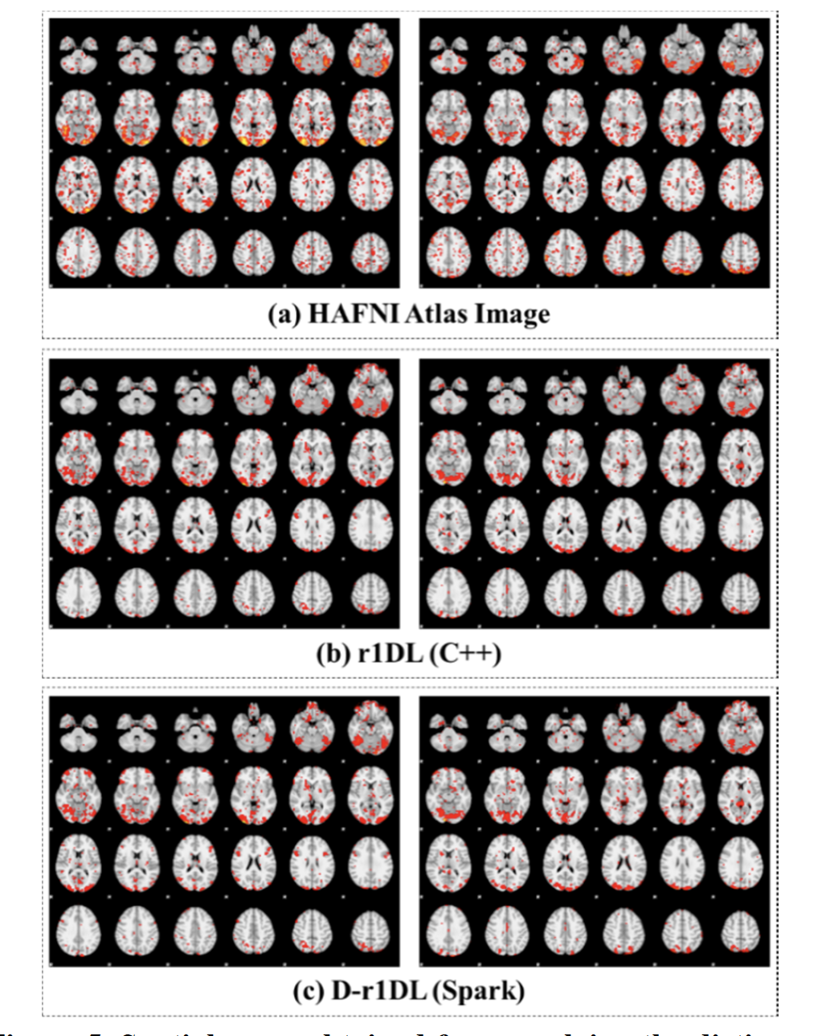
EXPERIMENTAL APPLICATION ON BRAIN FUNCTIONAL IMAGING DATA

Slide 15
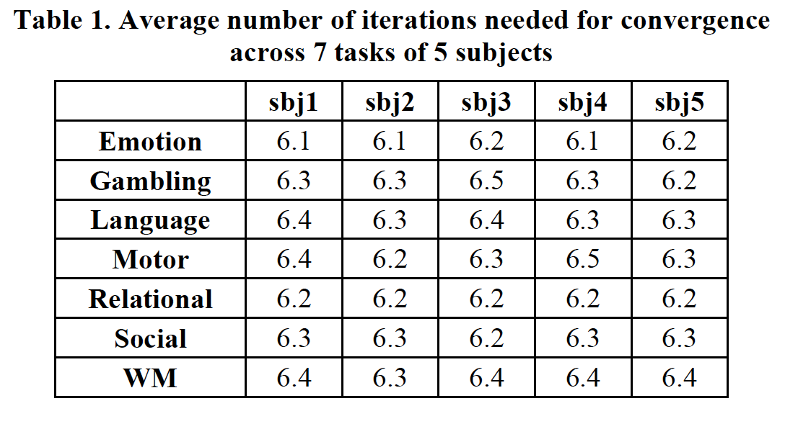

Slide 16
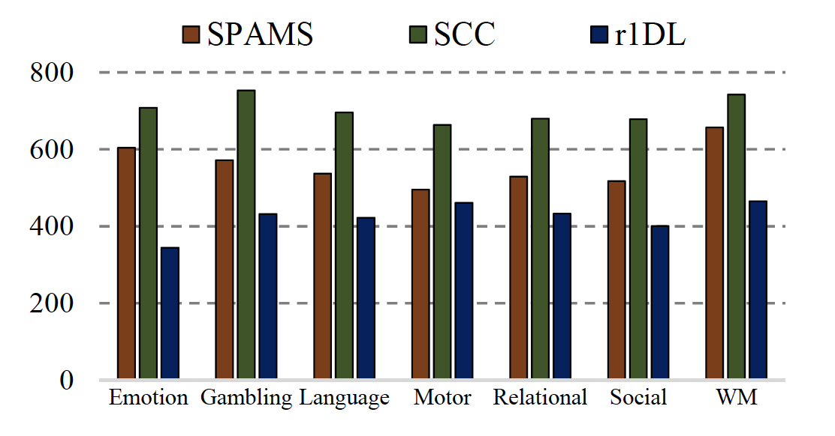
Performance boost by r1DL comparing with other dictionary learning algorithms
Notes:
functional network decomposition from individual tfMRI data during 7 tasks across 68 subjects, using the three dictionary learning methods.
stochastic coordinate coding (SCC)
used the r1DL implemented in C++

Slide 17
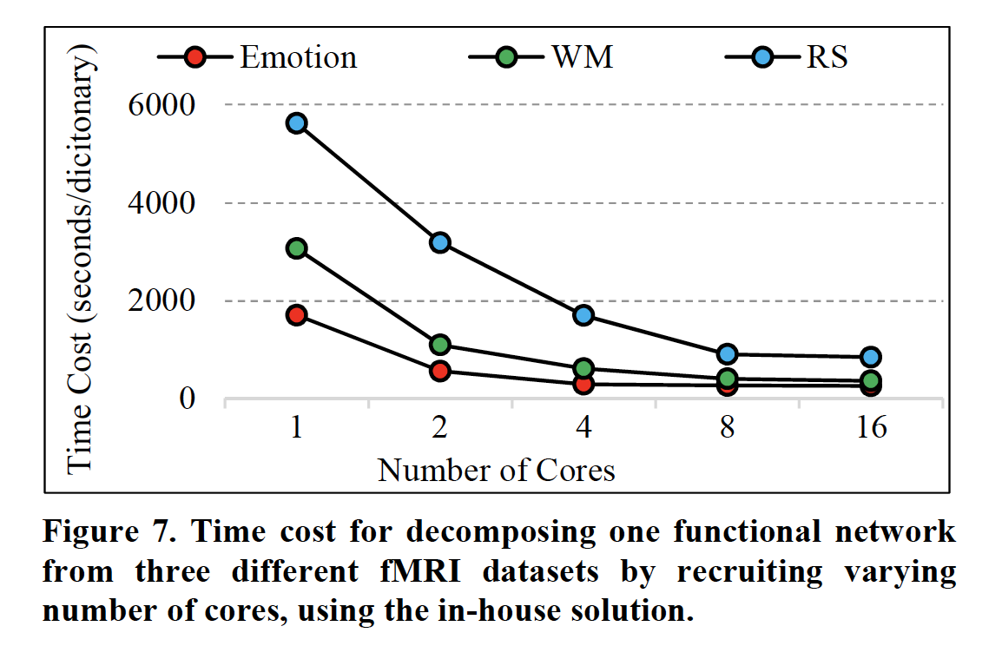

Slide 18
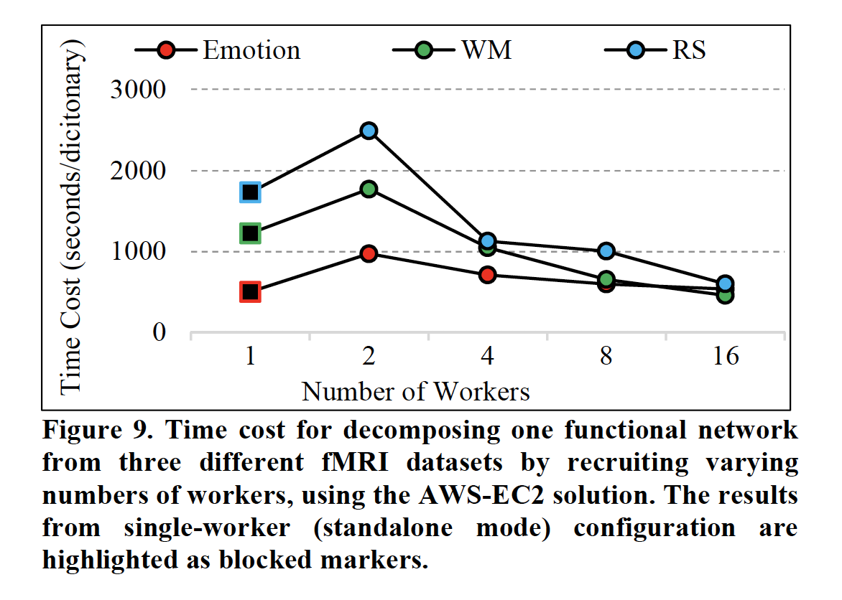

Slide 19
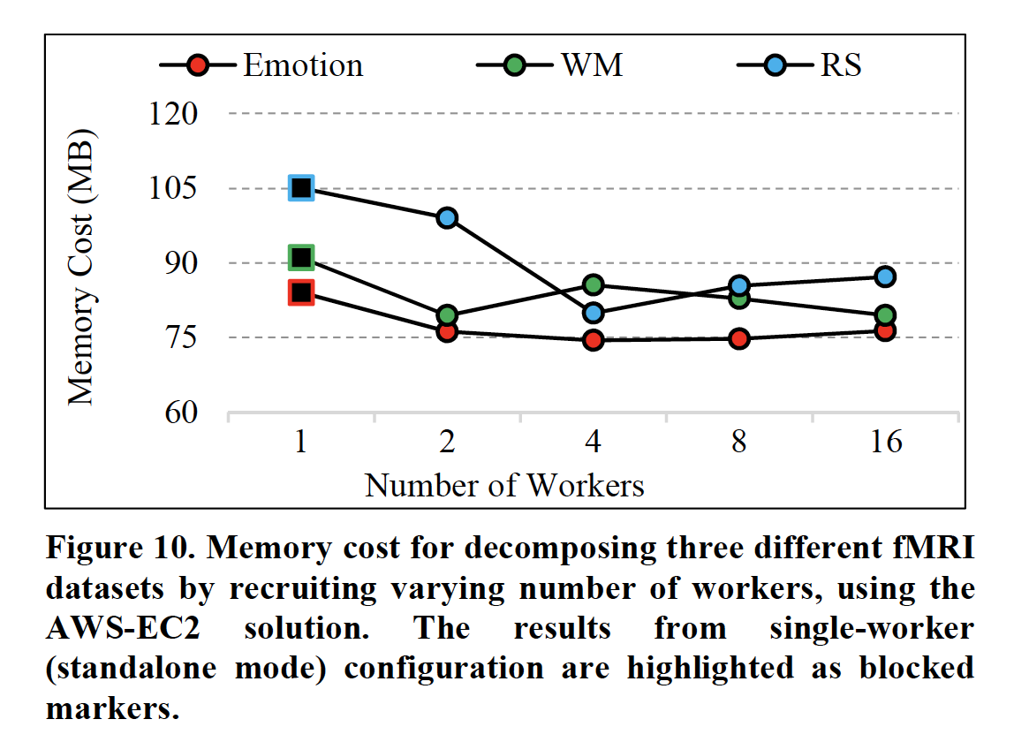

Slide 20
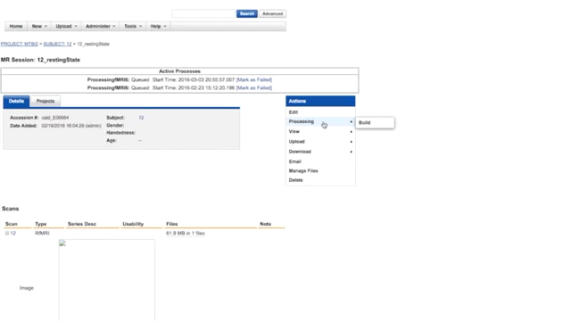
DEMO

Slide 21
CONCLUSIONS
dictionary learning model based on iterative rank-1 basis estimation.
The model was implemented and parallelized in Spark, and then deployed using the in-house solution as well as the AWS-EC2 solution.
ultimate goal : provide an integrated solution for functional neuroimaging big data management and analysis, enabling high throughput neuroscientific knowledge discovery
similar parallelization scheme could be implemented on other algorithms as well

